Slide 1
BenefitBridge: Proactive Entitlement Agent
People in crisis don't lack entitlements. They lack someone telling them.
Ashok Burasiya | 25 October 2026

Slide 2
Support goes unclaimed exactly when people need it most
21%
65 days
$160.8k
45 min
of eligible households enrolled within 30 days of a life event; baseline from 320 past events
median wait from a life event to a first claim
a year unclaimed across 50 of 141 households already on the agency's books
for a caseworker to check one household against all 12 schemes by hand
Diego Santos lost his job on 12 October. The agency got the employer's notice the same week, but nobody checked it against the rules: he is owed $13,600 a year across four schemes and has claimed none of them.
Source: 320 past life events (history.json), 141 household records and today's 40 events in the synthetic Aurelia dataset; time per check from caseworker interviews (Step 1).

Slide 3
Discovery: the agency knows, but nobody acts on what it knows
Primary persona
“I only find out a family was entitled to help when they are already in crisis.”
Priya Nair, Senior Caseworker
Priya, caseworker
• 160 open cases across Riverside and Northport; 11 years at the agency.
• Inbox of registry notices, hospital summaries, employer notices and citizen messages in 7 languages.
• Checks only the scheme a citizen asks about, because a full check takes 45 minutes.
• Goal: reach families before the crisis, and get every amount right first time.
“I can't check 12 schemes for every notice that comes in.”
Priya, caseworker
“If I get an amount wrong, it's on me.”
Priya, caseworker
“I wish the death registry told me before the funeral, not after.”
Citizen, recently bereaved

Slide 4
Five whys lead to one root cause: services wait to be asked
1
2
3
4
5
Support comes late
People don't apply
The agency doesn't tell them
A check takes 45 minutes
Built for 'pull'
42% of households with a life event claimed nothing in a year.
They don't know which of 12 schemes fit, and forms repeat the same questions.
It receives the event, but nobody checks it against every scheme.
Facts sit in free text, records are stale, rules span 12 rulebooks.
Every process starts when the citizen applies.
Root cause
No step turns a life event the agency already receives into a checked, explained offer of help that a caseworker can approve. The fix is to make the agency act first, not to make citizens try harder.

Slide 5
Today's queue shows the gap household by household
Event | What came in | What BenefitBridge found | Unclaimed / yr
Lukas Kim, bereaved (E-2018) | Death registry: wife died 16 October | Housing Support, Age Pension, Winter Energy; message in Mandarin | $17,650
Diego Santos, job loss (E-2007) | Employer notice + phone note | 4 schemes; income and savings in the record were out of date | $13,600
Omar Torres, separation (E-2036) | Citizen web message | Housing Support and Childcare, but he opted out of contact: no draft | $7,980
Hana Fischer, stroke (E-2020) | Hospital discharge summary | Carer Allowance for her partner; Disability Support needs an assessor | $3,840
Maya Silva, eviction (E-2029) | Caseworker phone note | Crisis: ranked Urgent, Hardship Grant sent to a caseworker | Urgent
Lukas Mensah (E-2033) | Web message in Spanish | Offline mode can't read it, so a person reads it first | Read now
Across all 40 events: 29 households with support they are not claiming, worth $208,720 a year; 1 urgent; 2 unreadable; 5 need a caseworker decision.

Slide 6
We scored 14 AI opportunities and built the top seven
Built: the seven Do-first ideas
Folded into four MVP features. The eligibility check scores highest and is the one place we refused to use AI: entitlement is law, so it is code that cites clauses.
Parked on purpose
Auto-award, auto-send, fraud scoring and mining bank or tax data. Each is either a legal decision that needs a person, a trust risk, or not the problem we found.

Slide 7
Four features, one rule: AI reads, rules decide, people approve
F1
F2
F3
F4
Read the event
Check every scheme
Draft the outreach
Pre-fill and log
Pulls 14 facts from any source and language, each with the exact words it came from; drops any fact without one.
All 12 schemes on every event. Eligible, needs info, or caseworker decides, each with the clause behind it.
Short message in the citizen's language with only rule-approved schemes and amounts; safety-checked.
Applications filled from the record; every approval and rejection logged with who and when.
Groq first, Claude backup
Plain code, no AI
Groq/Claude + 4 safety checks
Data mapping, no AI
The caseworker decides. Approve, edit or reject. Edits re-run the safety checks. Nothing is awarded or sent by the AI, Disability Support and Hardship Grants always go to a person, and people who opted out get no message.

Slide 8
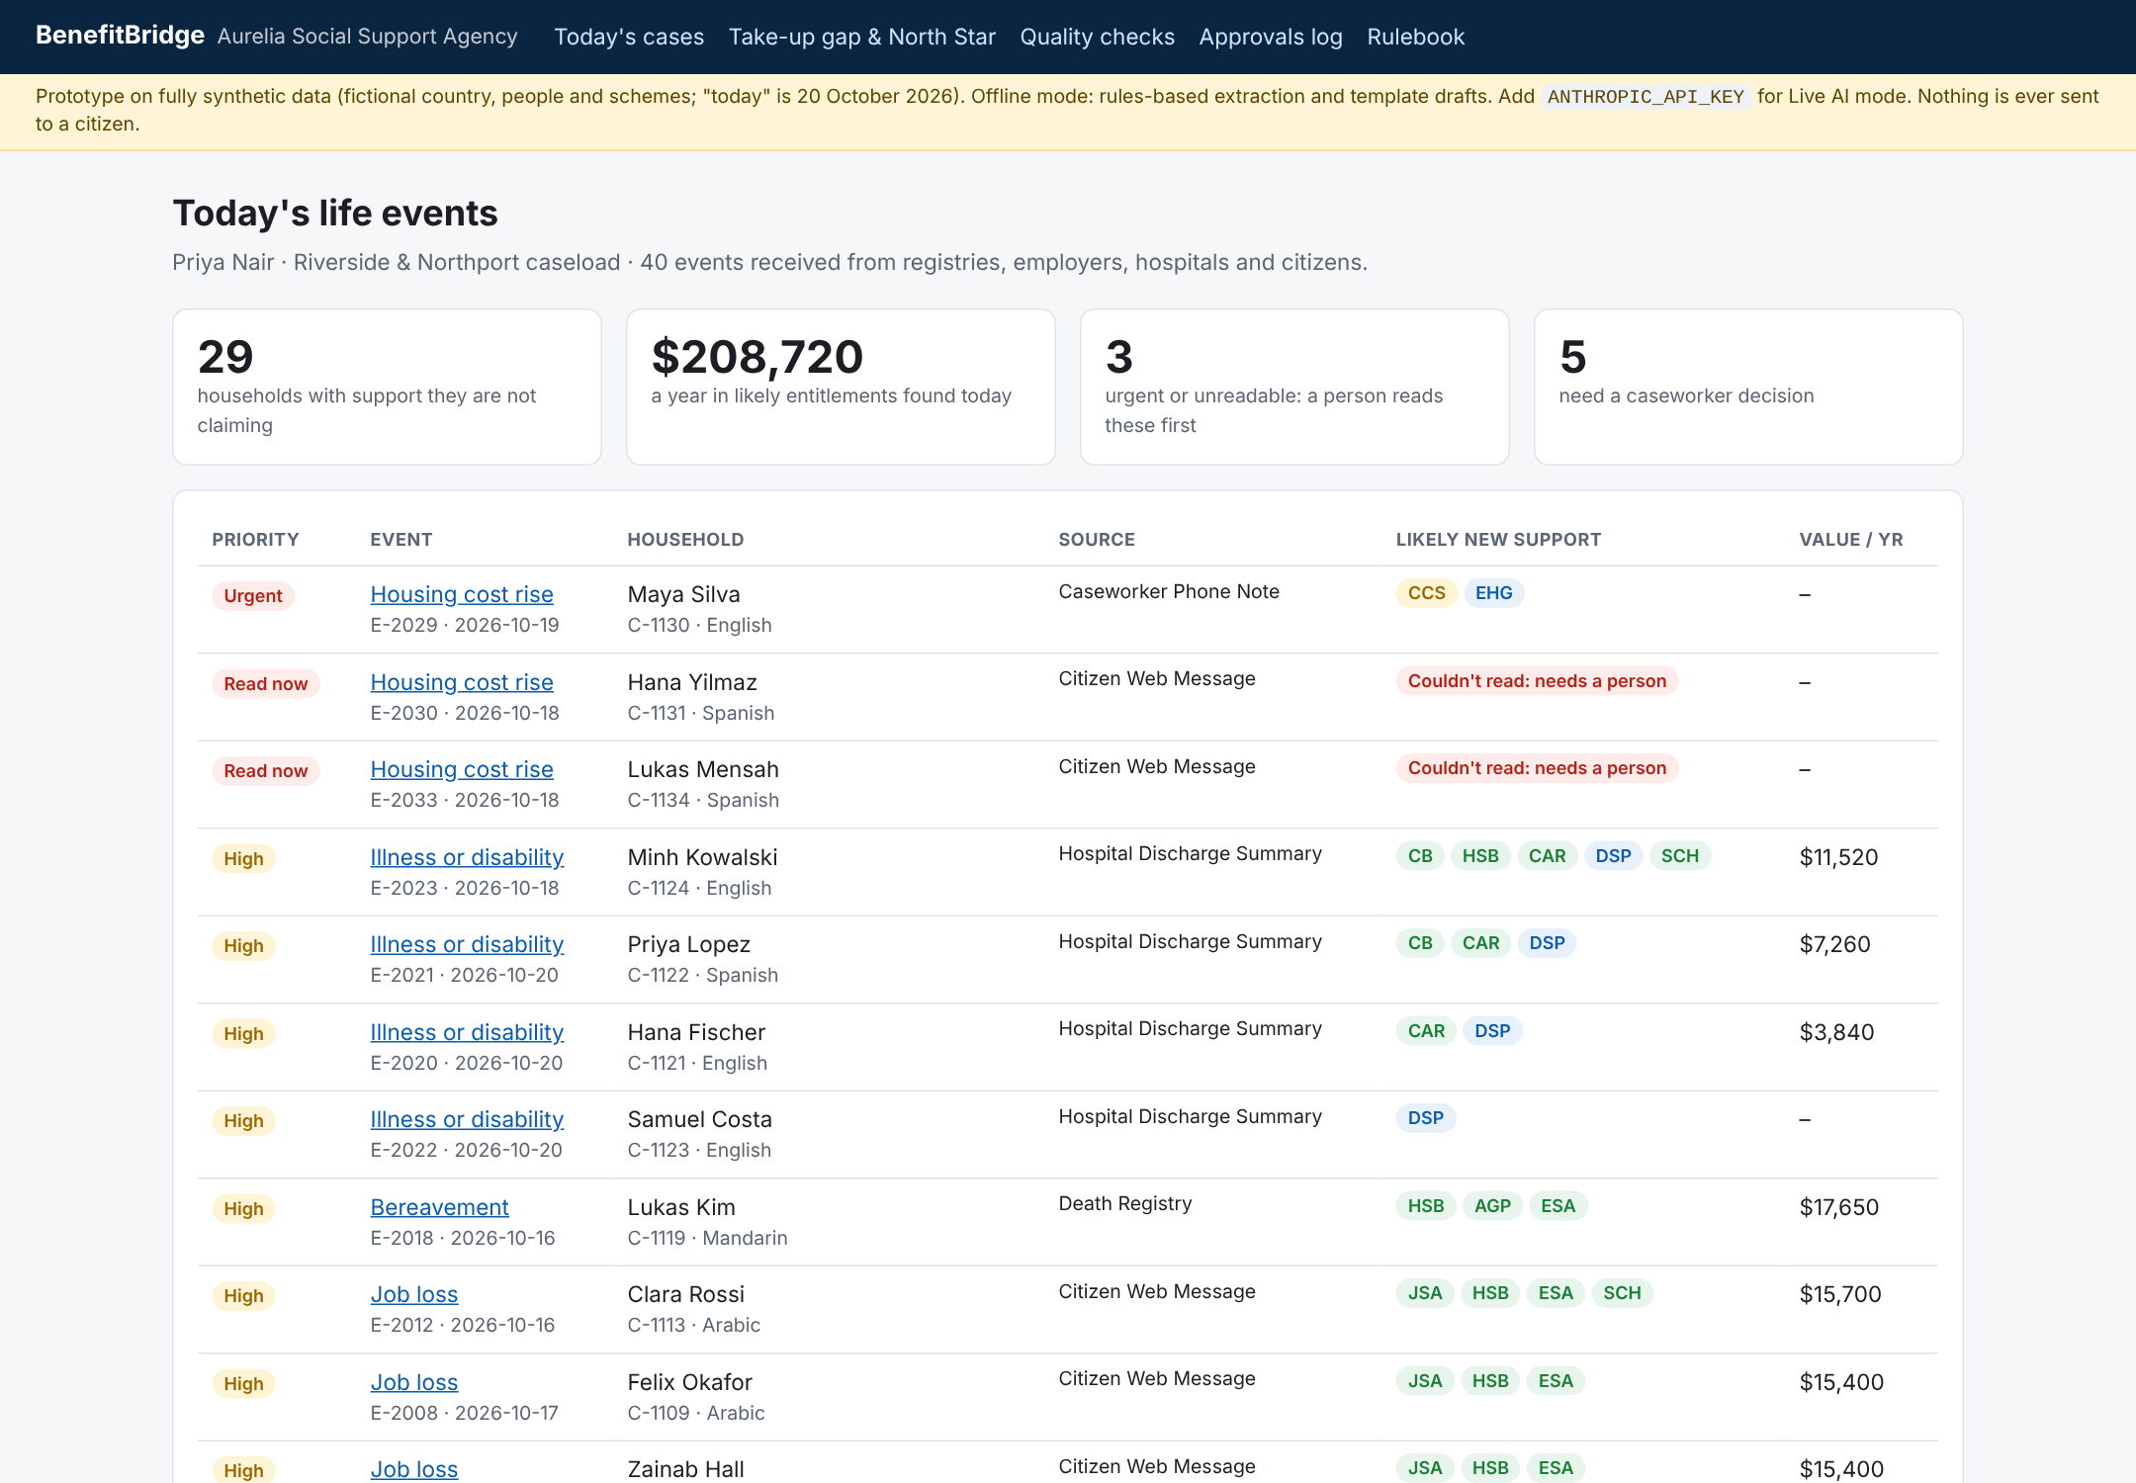
8:00 am: Priya sees who needs her first, and what they are owed
1
Crises before value
An eviction note ranks Urgent; two messages it couldn't read rank Read now.
2
Money on every row
29 households, $208,720 a year in support they are not claiming.
3
Language travels
Mandarin, Arabic and Spanish speakers get messages in their own language.
4
Nothing filed as 'no action' by accident
Unreadable means a person reads it.

Slide 9
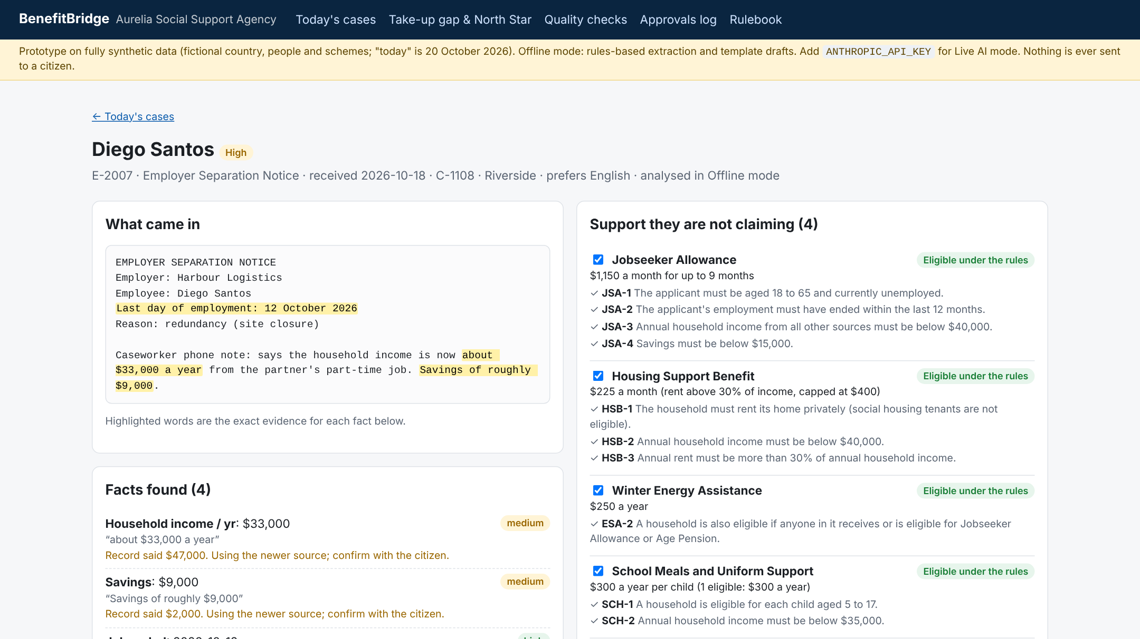
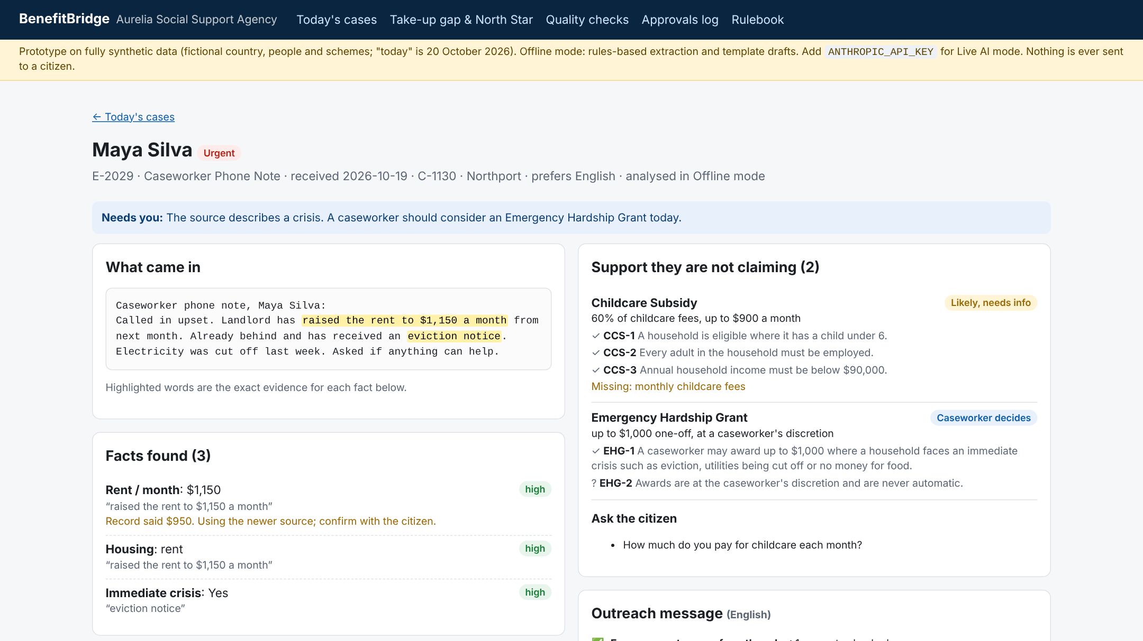
Grounded in evidence, gated by people
Grounded. Every fact is highlighted in the source. The record said $47,000 income; the notice says $33,000, so the newer source wins and the conflict is shown. Each scheme cites its clauses.
Human in control. An eviction and a power cut make this Urgent. The Hardship Grant is marked Caseworker decides, never eligible, and a missing fact becomes a question instead of a guess.

Slide 10
Rules where they must be, models where they help
Read
14 facts, JSON output, verbatim quotes
Groq · Claude
Under 1 cent a case
About $132 a month for 22,500 life events: Groq gpt-oss-120b on every event ($21), Claude Opus 5.5 as backup on a budgeted 10% ($66), plus $45 of hosting and database. Claude-only would be about $707.
Verify
Drop any fact whose quote isn't in the source
Code
Update
Newer source wins; conflicts shown
Code
Decide
12 schemes, clause citations
Code
Prototype stack
• Next.js on Vercel's free tier, no paid database
• Groq first, Claude if a Groq call fails; rules-only Offline mode with no key
• No vector store: the rulebook is about 2,000 tokens and lives in code
Draft
Citizen's language, rule amounts only
Groq · Claude
Check
4 safety checks, re-run on every edit
Code

Slide 11
North Star: enrolled within 30 days, from 21% to 60%
Supporting metrics: today and target
Time to support
65-day median to first claim → under 14 days
Caseworker time
45 minutes per review → 10
Trust
85%+ of suggestions approved without major edits
Quality
Entitlement precision 95%+, recall 90%+
Fairness
No language or region more than 10 points below average
Guardrails
0 unapproved messages, 0 unquoted facts, 0 contacts after opt-out

Slide 12
The North Star leads; outcomes for families follow
Lagging: outcomes it should drive
Leading: the product controls it
Enrolled within 30 days
Unclaimed support
Annual value of support eligible households are not getting.
$160,770 across 50 of 141 households today; target down 50% in a year.
Moves weekly. Measures the exact failure we found: support arriving late or never.
21% today, 45% in the pilot, 60% at full rollout.
Can't be gamed by sending more messages: it counts enrolments, not outreach.
Emergency grants
Hardship grants paid to households that were owed regular support.
Baseline set in shadow mode; should fall as support arrives earlier.
Repeat contact
Calls and visits per household in the 90 days after a life event.
Baseline set in shadow mode; fewer chasers, fewer re-applications.
Claimed nothing in a year
Households with a life event who claimed nothing within 12 months.
42% today; target under 15%.
Counter-metric: complaints about unexpected contact and messages sent that lead to no claim. Target under 1% and tracked by language, so reaching more people never means pestering them.

Slide 13
Passes every launch eval, offline and live on Groq
0 / 0 / 0 / 0
unquoted facts shown, caseworker-only schemes marked eligible, drafts to opted-out people, crises missed without a person
The build is the gate
Labels come from an independent Python version of the rules, so the engine is checked against something it didn't produce. Deployment fails if any threshold fails. Live mode reads the Spanish eviction message that Offline mode can only flag, and gets all 40 cases exactly right.

Slide 14
The highest risks, and the guardrail for each
A wrong amount or promise reaches a citizen
Amounts only from the rules; promise language blocked; failing drafts can't be approved; checks re-run on every edit.
The AI invents a fact
Every fact must quote its source verbatim, or it is dropped. Eval: 0 unquoted facts shown.
The AI decides who gets support
Eligibility is code citing law. Disability and Hardship always go to a person.
A crisis is missed
Hardship ranks Urgent; anything unreadable ranks Read now. Eval: 0 silent misses.
Contact feels like surveillance
Only events the agency already receives; opt-out respected; no protected traits or fraud scoring.
Kill switch: any message or award without approval, any unquoted fact or unapproved amount, any missed crisis, or any contact after opt-out returns the region to the manual process.

Slide 15
Rollout earns trust in stages
Oct 2026
Q1 2027
Q2 2027
Q3–Q4 2027
Prototype on synthetic data
Shadow mode, one region
Assisted pilot, 10 caseworkers
Phased to national
Gate: every launch eval passes
Nothing sent. Gate: live evals pass on 500 real events; DPIA signed
Gate: 85%+ approvals, 0 breaches, reviews under 15 min
Gate: 30-day enrolment +15 points; no group gap over 10
Done: working prototype
Next after the MVP: document upload and checking (payslips, leases), and a citizen-facing assistant on the same rules. Auto-send for low-risk cases only after six months with zero incidents.

Slide 16
Next: shadow mode in one region, Q1 2027
Approve read-only access to registry and employer feeds for one region
Run the live evals on 500 real events; nothing is sent to citizens
Decide on the assisted pilot with the eval and North Star data
Try it: npm run dev (Offline mode needs no key) · deploys to Vercel's free tier

